Slide 1
DATA-CAN PPIE Drop-in session “Mental health data”

Slide 2
Areas to cover
What data is collected about mental health and illness?
What is reported and available?
What can/could the data be used for?
(These slides are England-focused, with thanks to NHS Digital)

Slide 3
Scope and scale
16 million people in the UK experience a mental illness
Three in four mental illnesses start in childhood
10% of school children have a diagnosable mental illness
75% of young people with a mental health problem are not receiving treatment
The average wait for effective treatment is 10 years
Suicide is the biggest killer of young people in the UK
People with severe mental illness die between 10 and 20 years earlier than the general population
More than half of young people link mental illness with alienation and isolation
More than half of young people feel embarrassed about mental illness
Just 6% of UK health research spending goes on mental health
For every person affected by mental illness, £8 is spent on research – 22 times less than cancer and 14 times less than dementia
Less than 30% of mental health research is focused on young people
Source: MQ

Slide 4
The Mental Health Services Dataset
The MHSDS is a national information standard
MHSDS v4.1 (DCB0011) is the latest version of the information standard to be approved by the Data Coordination Board (DCB), data collection for v4.1 commences 1 April 2020, replacing the previous v4.0 collection.
The information standard defines the data items, definitions and associated value sets to be extracted or derived from local information systems.
The associated ISN's and standard documentation can be found on the DCB0011 publication page.
Previous versions of the MHSDS are available on the government national archives site.

Slide 5
How is the Mental Health Services Dataset used?
Commissioning services
Clinical audit
Research
Service planning
Inspection and regulation
Monitoring government policies and legislation
Local and national performance management and benchmarking
National reporting and analysis
Payment/funding

Slide 6
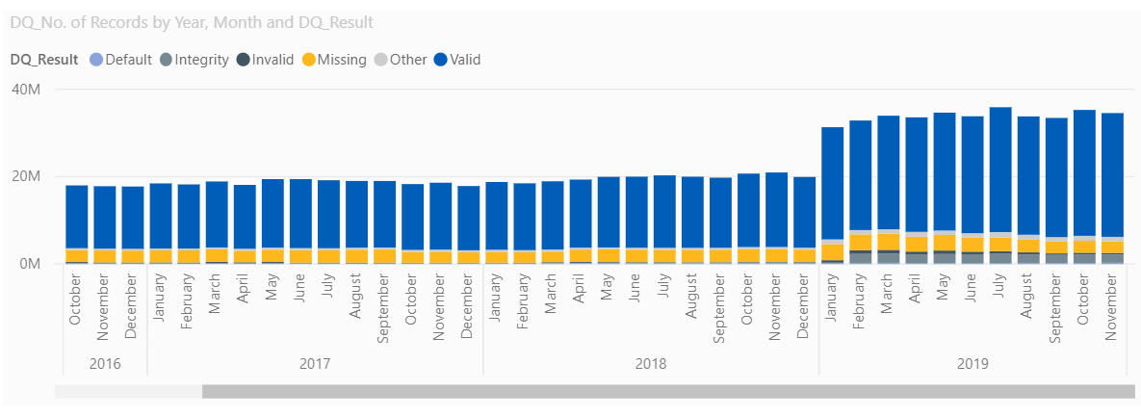
The dataset through time…..
Historically, was not well collected
Much more comprehensive datasets over recent years

Slide 7
Online data analysis tools
Mental Health and Wellbeing JSNA
Perinatal Mental Health
Children and Young People's Mental Health and Wellbeing
Common Mental Health Disorders
Co-occurring Substance Misuse and Mental Health Issues
Crisis Care
Severe Mental Illness
Suicide Prevention
Dementia

Slide 8
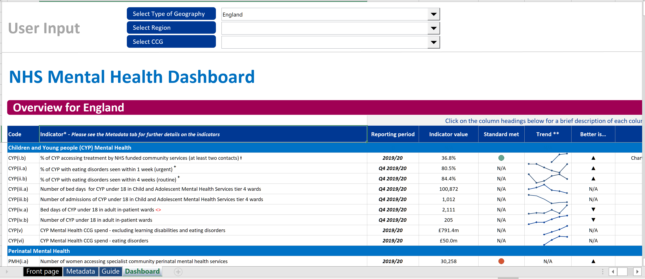

Slide 9
Take away points
There is much better recording of data in recent years
Mental health covers a wide range of dimensions
Types of mental health problem
Prevalence
Across children, young people, older people
Mental health at work
Social factors
Prevention and treatment
Costs

